Slide 1

Learning grain boundary segregation energy spectra in polycrystals
Caimei Niu
Jiayi Fu
Cheng Chen

Slide 2
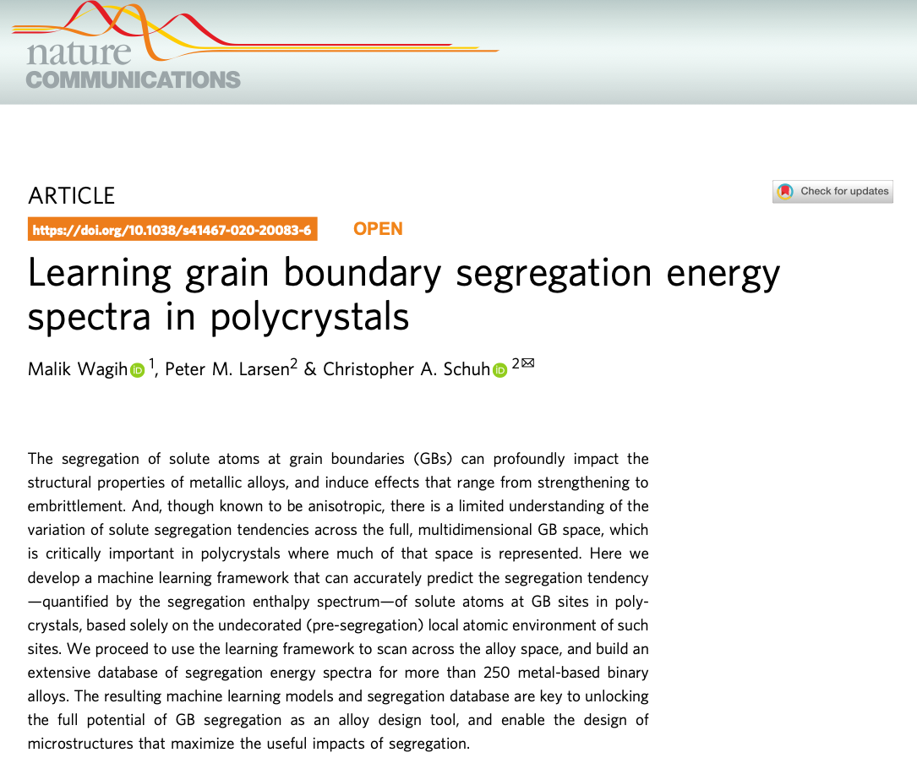
1. Paper Overview
Challenge:
Segregation energies vary across grain-boundary sites
Al polycrystal can contain about 10⁶ grain boundary sites
Direct atomistic calculation of all GB sites is too expensive
Core idea:
Predict segregation energy from undecorated local atomic environment with machine learning.
Main outcome:
ML framework for segregation energy spectra
Database for 259 binary alloys
Notes:
The physical phenomenon here is grain-boundary segregation. In a polycrystalline alloy, solute atoms often prefer to move to these grain-boundary sites instead of remaining in normal bulk crystal sites, because this can lower the energy of the system. And the segregation can affect many properties, like strengthening, corrosion resistance and microstructural stability.
The main problem is that a polycrystal contains many different grain-boundary sites, and they are not all equivalent. Because of this, one alloy does not have a single segregation energy, but a whole spectrum of segregation energies. In principle, we can calculate the segregagtion energy site by site, but it is expensive in real polycrystals. For example, given in the paper, a (50 nm)³ Al polycrystal with an average grain size of ~10 nm contains about 10⁶ (one million) grain boundary sites, which means about one million atomistic calculations.
So the authors proposed a way to predict a site’s segregation energy directly from its pre-segregation local atomic environment. That is the central idea of the paper: instead of solving every site from scratch, learn a mapping from local structure to segregation energy. The final goal is not just to predict one average value, but the whole segregation-energy spectrum across the grain-boundary network.

Slide 3
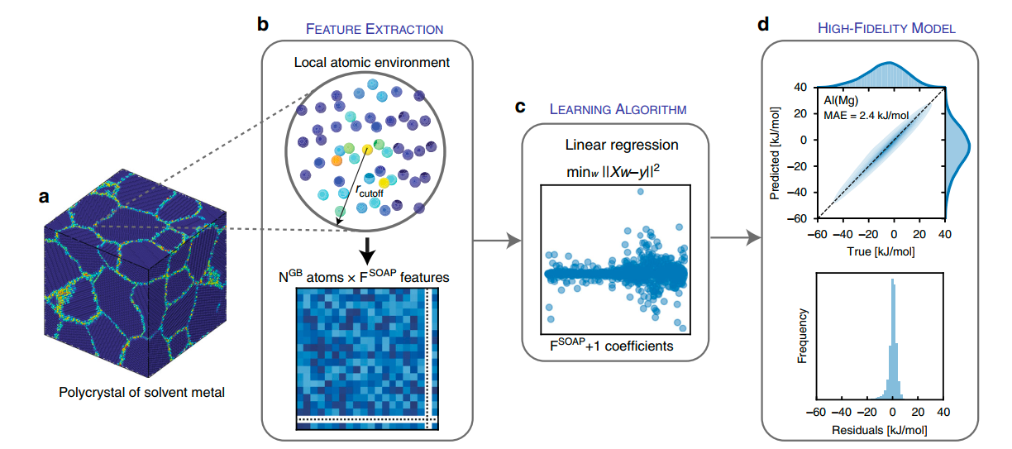
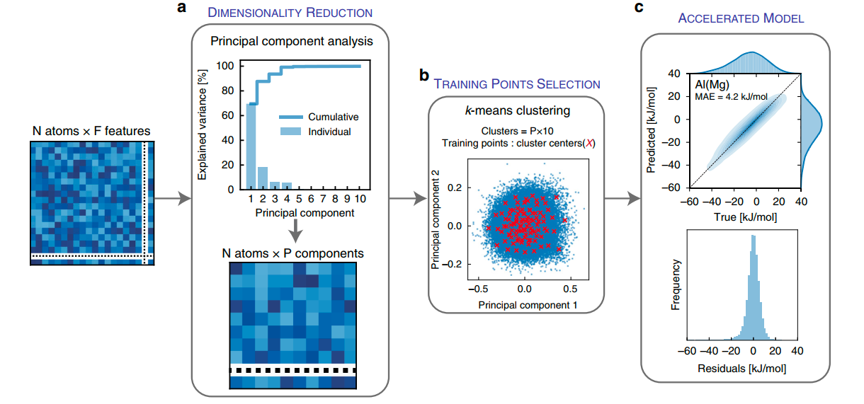
2. Main Method Used in the Paper
Workflow:
Build and relax a polycrystal
Compute segregation energies for selected sites
Encode each site with SOAP descriptors
Train a linear regression model
SOAP: fingerprint of the local atomic environment
Figure 1: High-fidelity ML model to learn Mg solute 36 segregation at GBs in an Al polycrystal.
Accelerated model:
Principal component analysis (PCA): 1015 SOAP features → 10 components
k-means clustering: select 100 representative training sites
Al(Mg): MAE ≈ 4.2 kJ/mol
Figure 2: Accelerated ML model for GB segregation.
Notes:
Now I will explain the methods used.
The workflow starts by building and relaxing a polycrystal. Then the authors compute segregation energies for selected grain-boundary sites. For each site, they compare the energy of a solute atom at that grain-boundary site and the energy of the same solute in a bulk crystal site. To describe each site before segregation, they use SOAP descriptors, Smooth Overlap of Atomic Positions. SOAP converts the local atomic environment into a numerical fingerprint. In this paper, the environment is described within a cutoff radius of 6 angstrom, and the SOAP vector has 1015 features. (SOAP is useful because it captures the local neighborhood in a symmetry-consistent way.)
Then these descriptors are then used to train a linear regression model that predicts segregation energy from local structure.
The authors also introduce an accelerated version of the method. They reduce the 1015 SOAP features to 10 principal components using PCA, and then use k-means clustering to choose 100 representative GB sites for training. (For Al-Mg, this accelerated model achieves a mean absolute error of about 4.2 kilojoules per mole using only 100 training points.)
Mean idea: rich local descriptor, simple regression model, and reduce data dimensions to make the method cheaper.

Slide 4
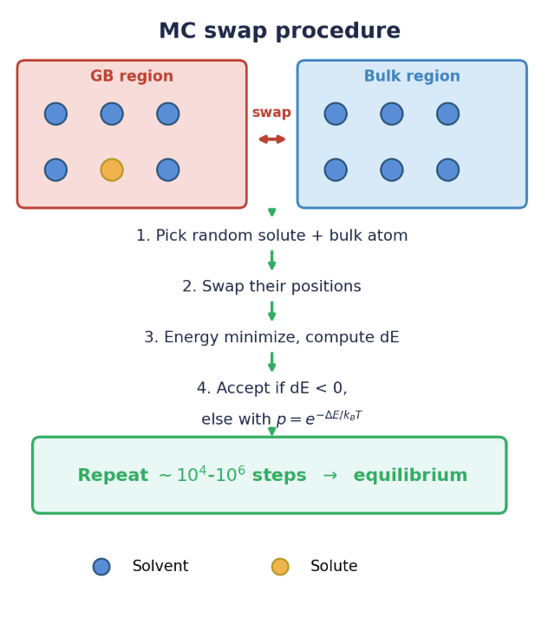
3. Our core idea: Hybrid Monte Carlo Validation
Wagih's Key assumption
Each GB site segregates independently
No solute-solute interaction is considered
Equilibrium predicted analytically via Fermi-Dirac statistics
Why HMC is the right test
HMC includes all interactions naturally
It gives the true atomistic equilibrium
Agreement -> Framework validate
Deviation -> reveals where it breaks

Slide 5
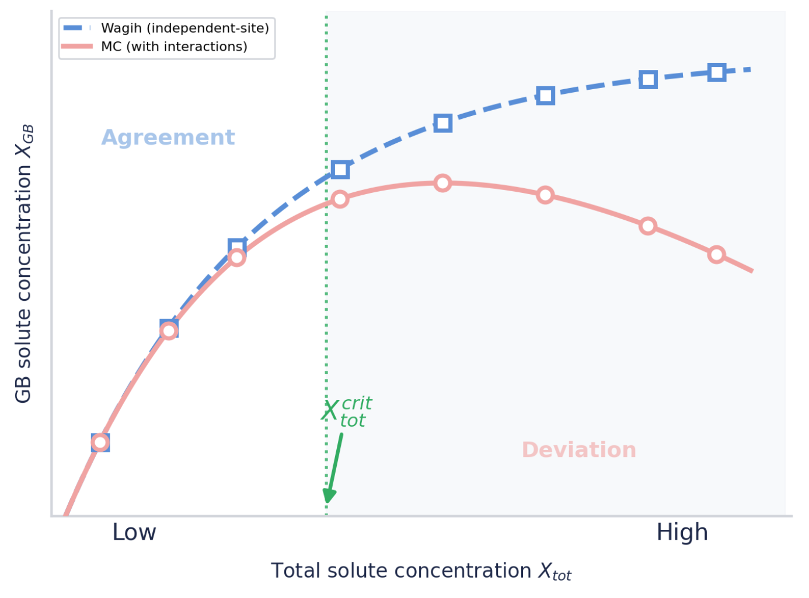
4. Project Extensions I​
Breakdown of the independent-site assumption
Compare HMC and Wagih at increasing solute concentration
Expect agreement at low concentration (dilute limit)
Deviation at higher concentration reveals the framework's limit
Analyze the origin: measure solute clustering via g(r)
Test whether site occupation Pi correlates with local solute density

Slide 6
5. Project Extensions II
Systematic temperature effects
Better ML training-point selection
Wagih: k-means selects 100 representative sites
Select training sites where prediction errors have the largest impact on X_GB — improving equilibrium accuracy or reducing labeling cost.
Use HMC ground truth to validate
The paper uses 0 K segregation energies
Monte Carlo can test segregation at finite temperature
Compare X_GB vs. T at 300 K, 600 K, 1000 K
These directions extend the project toward realistic physics and more efficient learning.

Slide 7
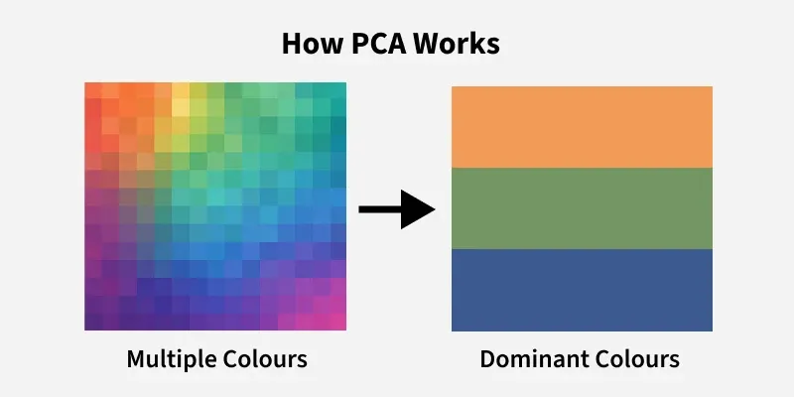
Principal component analysis (PCA):
Dimensionality reduction technique
Reduce the number of features in a dataset while keeping the most important information
It changes complex datasets by transforming correlated features into a smaller set of uncorrelated components
https://www.geeksforgeeks.org/data-analysis/principal-component-analysis-pca/
Notes:
It rotates your view of the data so the biggest pattern becomes easy to see.
Find the strongest shared direction
Rank the new directions
Keep only the first few

Slide 8
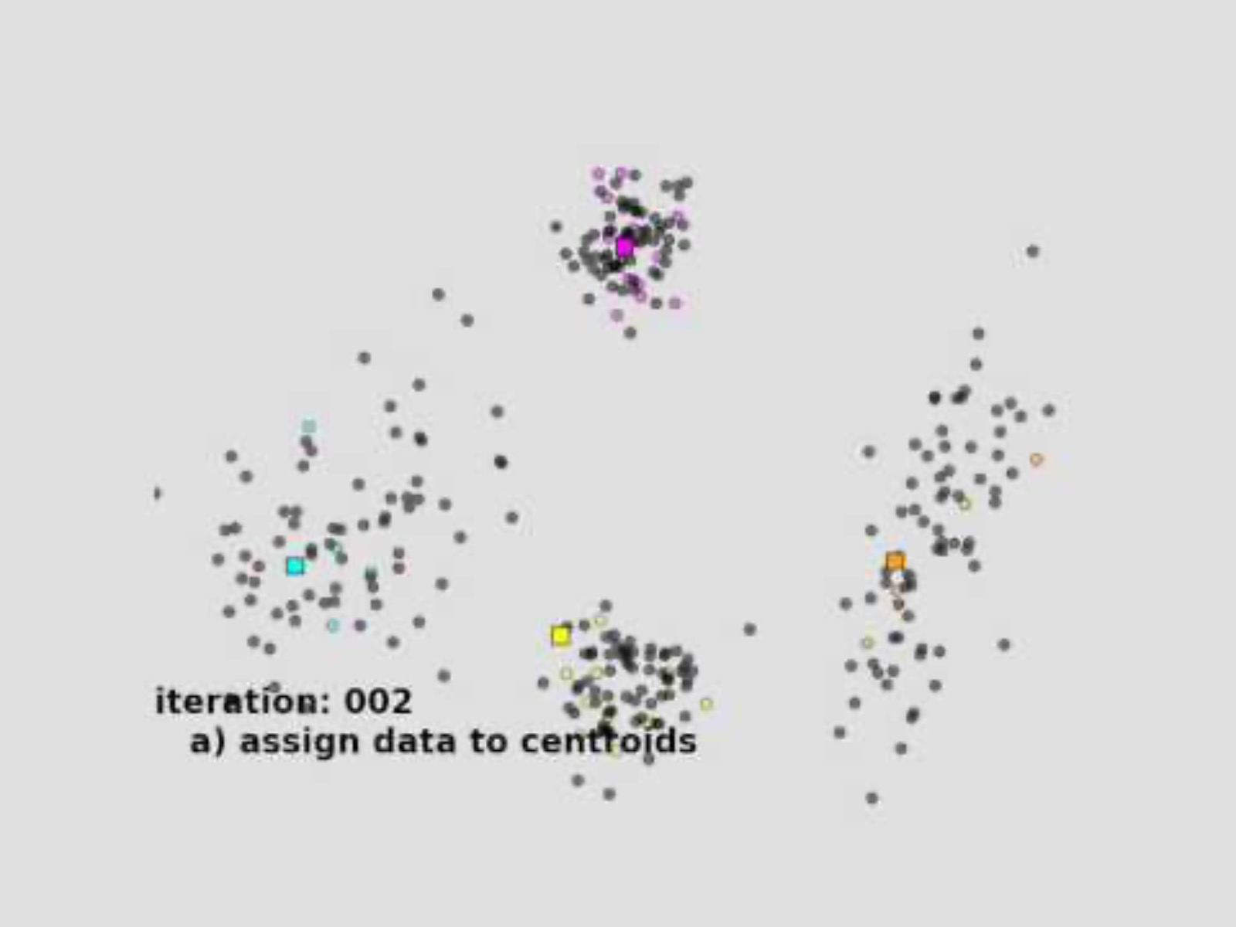
k-means clustering
https://www.youtube.com/watch?v=5I3Ei69I40s

